Slide 1
WEEK 19
CESAR A. PASCAL VASQUEZ
Week 19 | 1

Slide 2
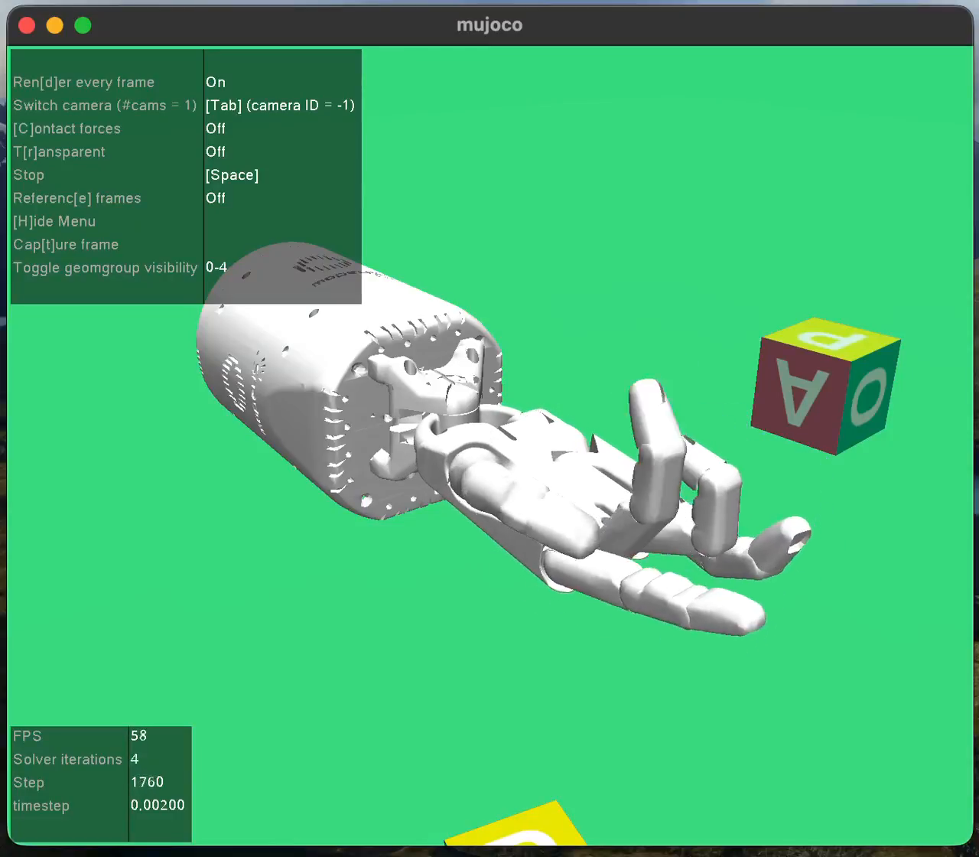
This week, the focus was advanced dexterous hand training and R1 hand integration.
After confirming the basic hand-reaching environment, I moved to a harder object-manipulation task. The goal was to train the Shadow Hand to rotate a block and then begin testing how a robotic hand could be attached to the Unitree R1 wrist in MuJoCo.
Week 19 | 2

Slide 3
The advanced task used the HandManipulateBlockRotateZDense-v1 environment.
Instead of only moving fingertips toward colored targets, this task requires the hand to make contact with a block and rotate it around the Z axis. This makes the training more difficult because the policy must coordinate multiple fingers while maintaining useful contact with the object.
The block task is more advanced because it requires contact, rotation, and coordination.
Environment: HandManipulateBlockRotateZDense-v1
Simulator: MuJoCo
Training method: SAC with HER replay buffer
Observation type: dictionary observations
Goal: rotate the block toward the desired target orientation
Week 19 | 3

Slide 4
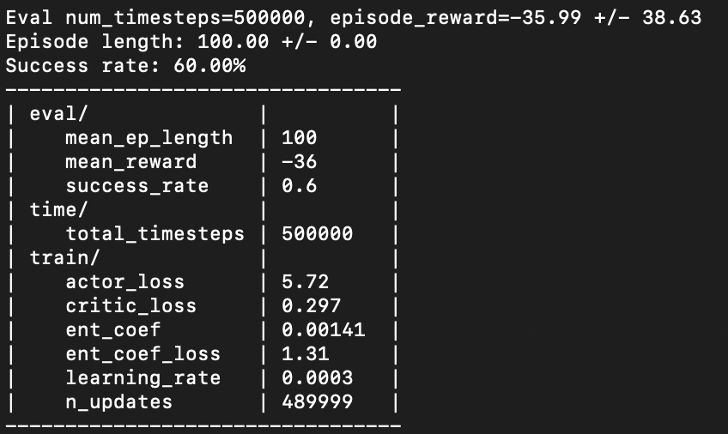
After longer training, the evaluation reached a 60% success rate at 500,000 timesteps.
60%
-36
100
success rate
mean reward
episode length
500k
timesteps
The stronger evaluation result shows clear progress compared with the first hand-reaching policy. The policy is still not perfect, but it is completing the block-rotation task more often after additional training.
Week 19 | 4

Slide 5
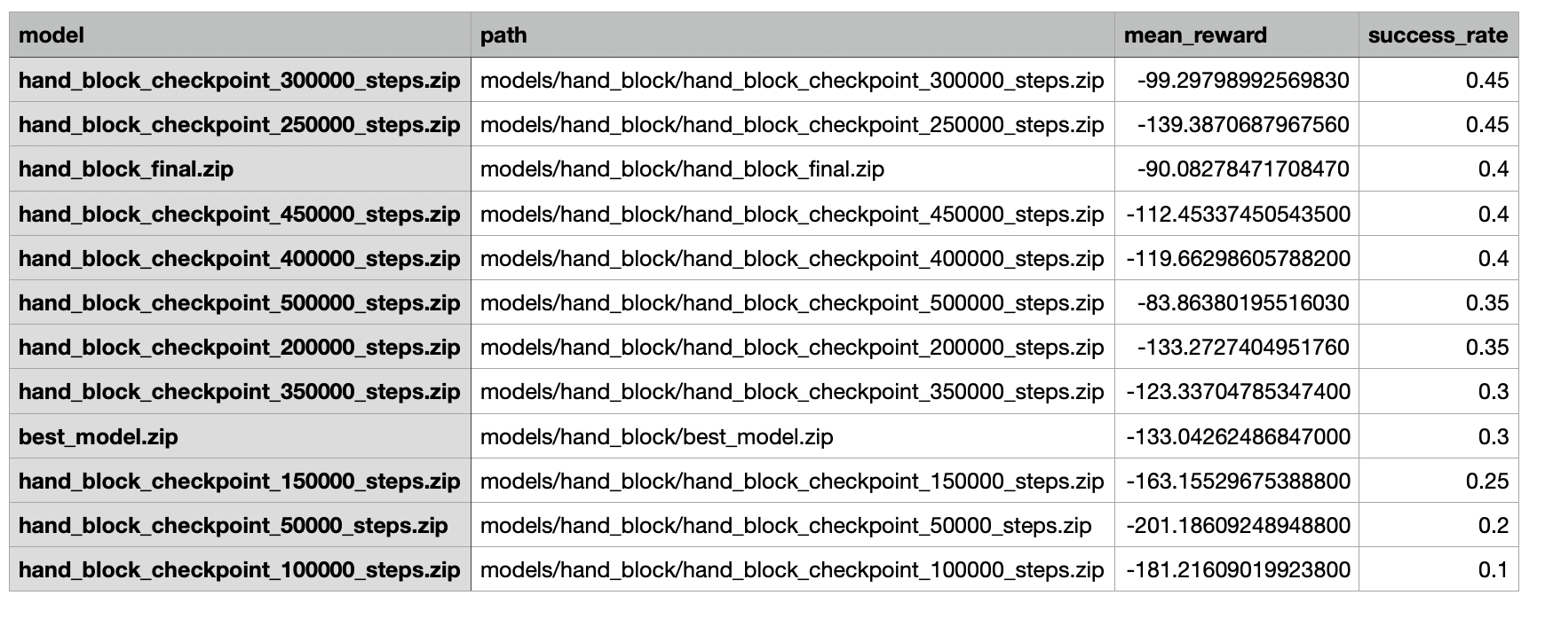
Checkpoint evaluation was used to select the best policy instead of assuming the final model was best.
The first evaluation sweep compared all saved checkpoints. The 300,000-step checkpoint had the best combination of success rate and reward in the original run, while later continued training improved the evaluation result to 45%. This shows why checking multiple checkpoints is important.
Evaluation table comparing saved hand-block checkpoints by reward and success rate.
Week 19 | 5

Slide 6
Policy visualization: the hand attempts to rotate and stabilize the block.
Video
Video 1: trained hand policy running in the block-rotation environment.
Week 19 | 6

Slide 7
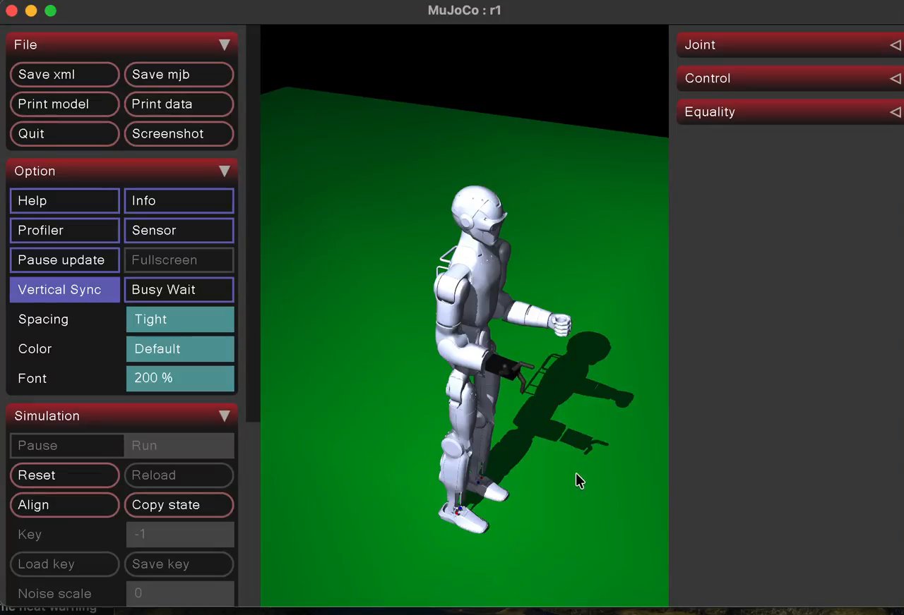
The next step was testing a simple robotic hand attachment on the Unitree R1 wrist.
Video
Video 2: early R1 + simple hand attachment test in MuJoCo.
Week 19 | 7

Slide 8
The R1 model was inspected to identify where the hand should be attached.
The right wrist body was identified as right_wrist_roll_link. The inspection showed that the original R1 hand was not an articulated hand, but mainly geometry attached to the wrist. This means it can be removed and replaced with a custom hand model.
Attachment body: right_wrist_roll_link
Original wrist joint: right_wrist_roll_joint
Original hand collision geometry: right_hand_collision
Current prototype: simple 3-finger hand
Testing mode: gravity disabled to inspect placement
Early prototype attached near the wrist; alignment still needs tuning.
Week 19 | 8

Slide 9
The main takeaway is that the hand policy improved, but integration still requires model alignment.
The training results show that the hand can learn a more advanced manipulation task, reaching a 60% success rate after additional training. At the same time, the R1 integration revealed practical model-building issues: the robot falls without a controller, and the hand must be aligned carefully with the wrist frame.
Positive result: block-rotation success rate improved to 60%
Best checkpoint selection is necessary because the final model is not always best
R1 right wrist can be used as an attachment point for a custom hand
Current limitation: hand position/orientation must be tuned so it replaces the original hand correctly
Next challenge: move from a simple hand prototype to a more realistic dexterous hand model
Week 19 | 9

Slide 10
Next steps are to improve the manipulation policy and build a cleaner R1 hand model.
The next phase should combine better policy evaluation with more careful MuJoCo model editing. The hand should first be aligned on the R1 wrist with gravity disabled, then tested with simple joint motions, and finally used in a task where the R1 arm and hand reach toward or grasp an object.
Continue training from the best checkpoint to push success above 70%
Tune the R1 hand attachment position and quaternion
Remove or replace the original right_hand_collision geometry cleanly
Test a small reaching or grasping scene with the R1 arm and hand
Later: replace the simple 3-finger prototype with a higher-DoF dexterous hand
Week 19 | 10

Slide 11
References
Farama Foundation. Gymnasium-Robotics: Shadow Dexterous Hand Environments.
Raffin, A., Hill, A., Gleave, A., Kanervisto, A., Ernestus, M., & Dormann, N. Stable-Baselines3: Reliable Reinforcement Learning Implementations.
Todorov, E., Erez, T., & Tassa, Y. (2012). MuJoCo: A physics engine for model-based control. IEEE/RSJ International Conference on Intelligent Robots and Systems.
Unitree Robotics. Unitree R1 MuJoCo model and deployment configuration resources.
Week 19 | 11

